Slide 1

git ops
john.rellis@setu.ie
Web Development 2

Slide 2

git ops
Well, we are not going to cover the entire scope of git driven operations BUT what we are going to do is us git to autodeploy our Dotify site on netlify

Slide 3
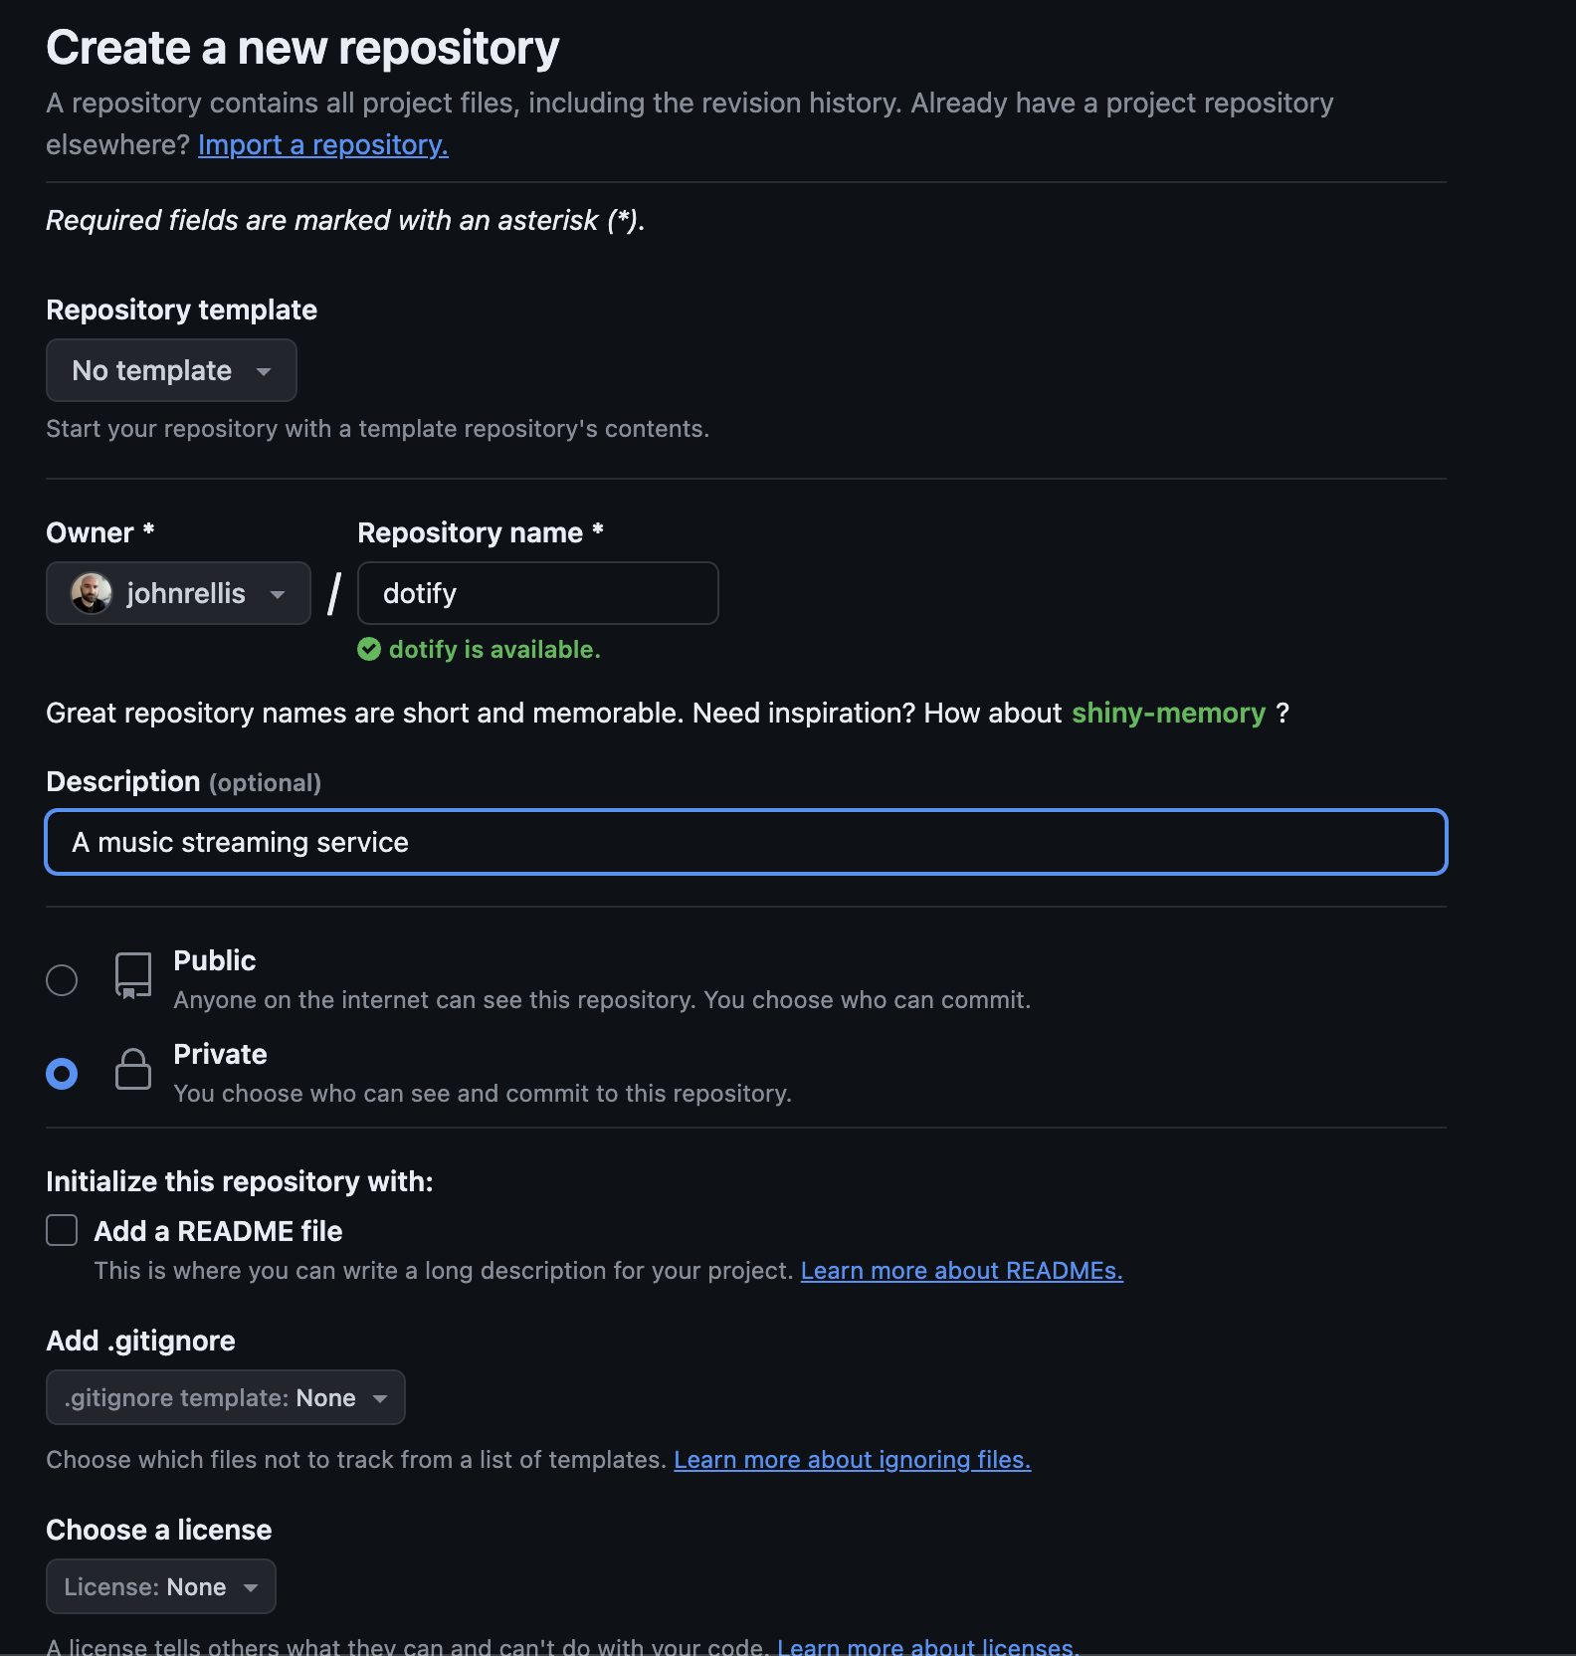
Lets get some code
Download the archive from tutors
<INSERT LINK HERE>
Unzip and open it in VS Code
Try and get vs code launching from your command line ;)
https://code.visualstudio.com/docs/editor/command-line
Now, create a new private repository in github
Do not add a README or Licence
Create the empty repo on github

Slide 4
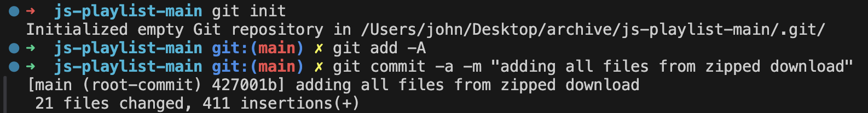
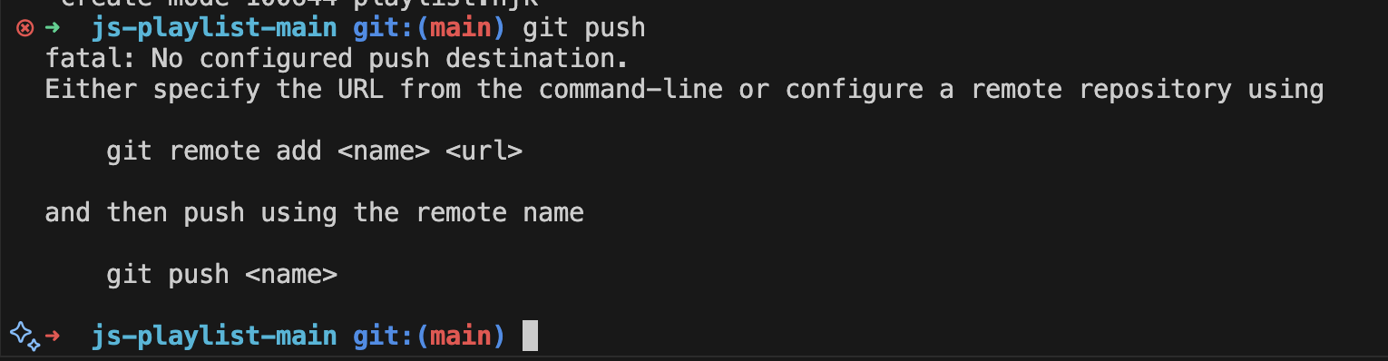
Back in VS Code
And push up to your repo
OH WAIT

Slide 5
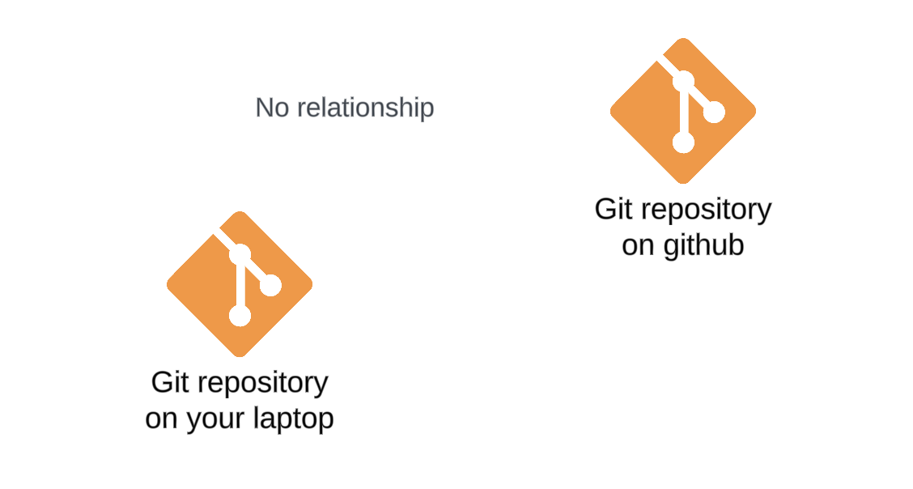
It didn’t work!
git push failed…. Why?
Well, all we did was unzip some code and commit them to our LOCAL git repo.
These have no relation to our REMOTE github repo.

Slide 6
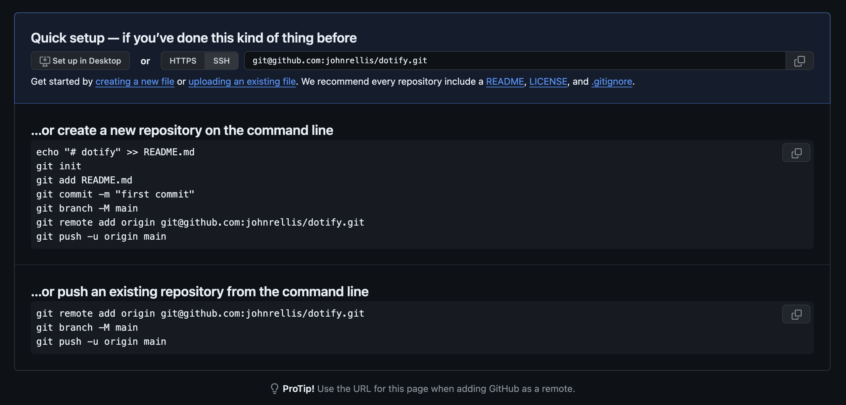
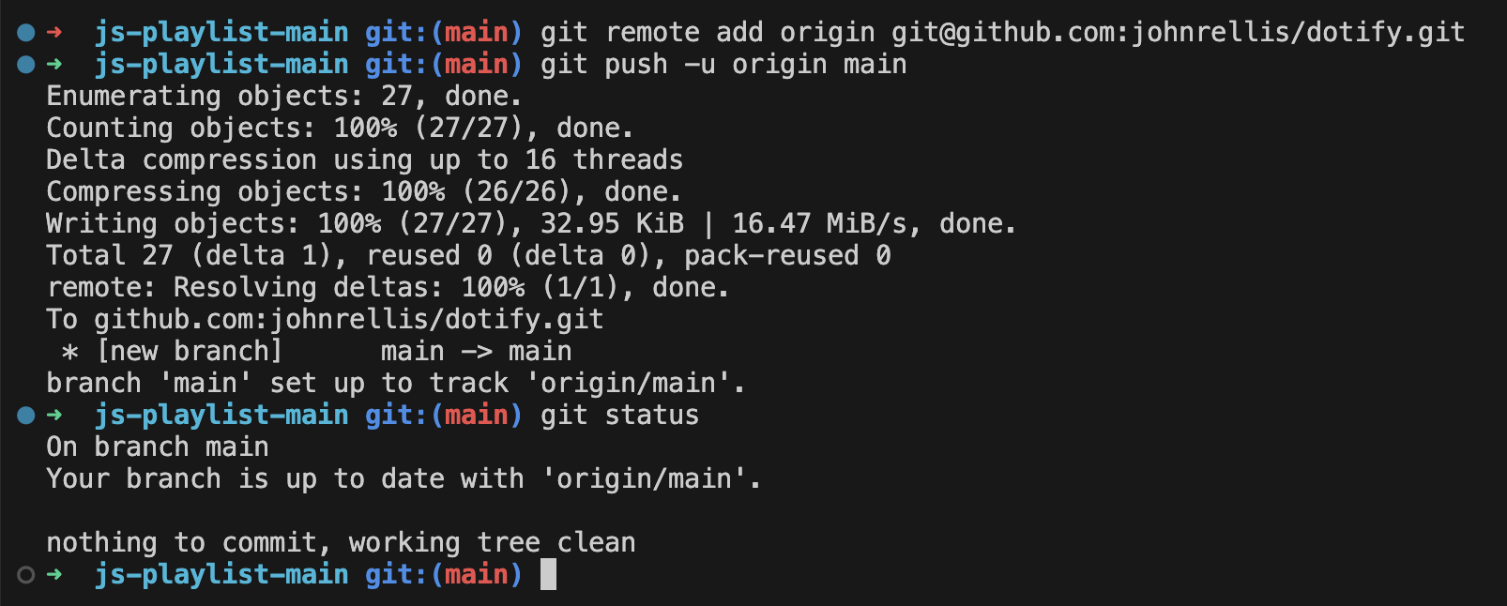
So, let’s add a remote to our local
github gives us some help here if we look at our empty repo link

Slide 7
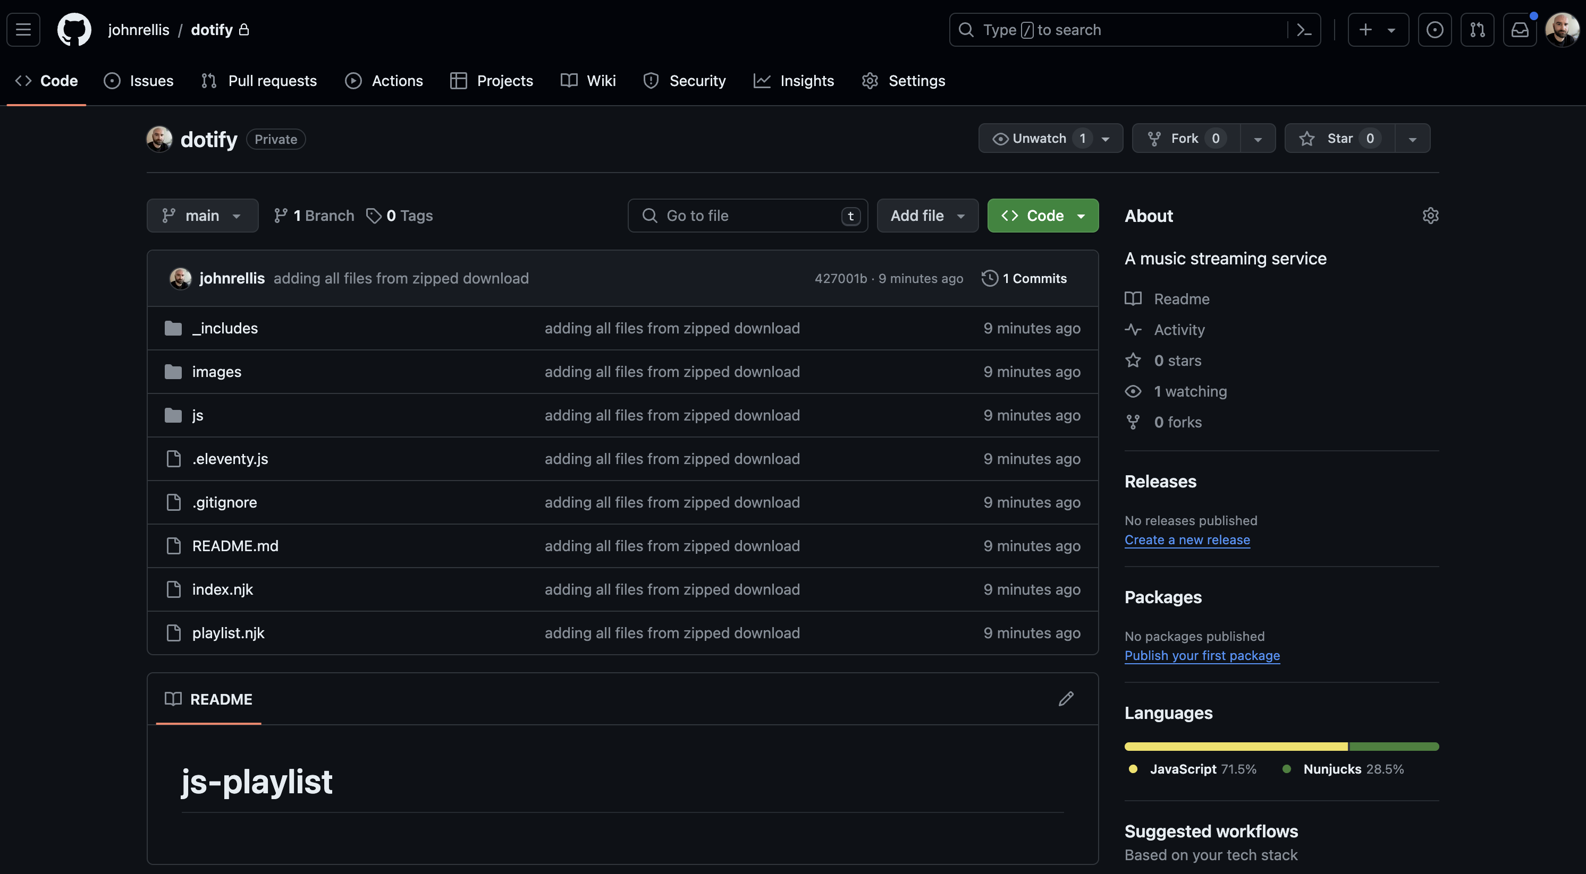
Refresh GitHub….

Slide 8

Great, we now have our code up on github

Slide 9
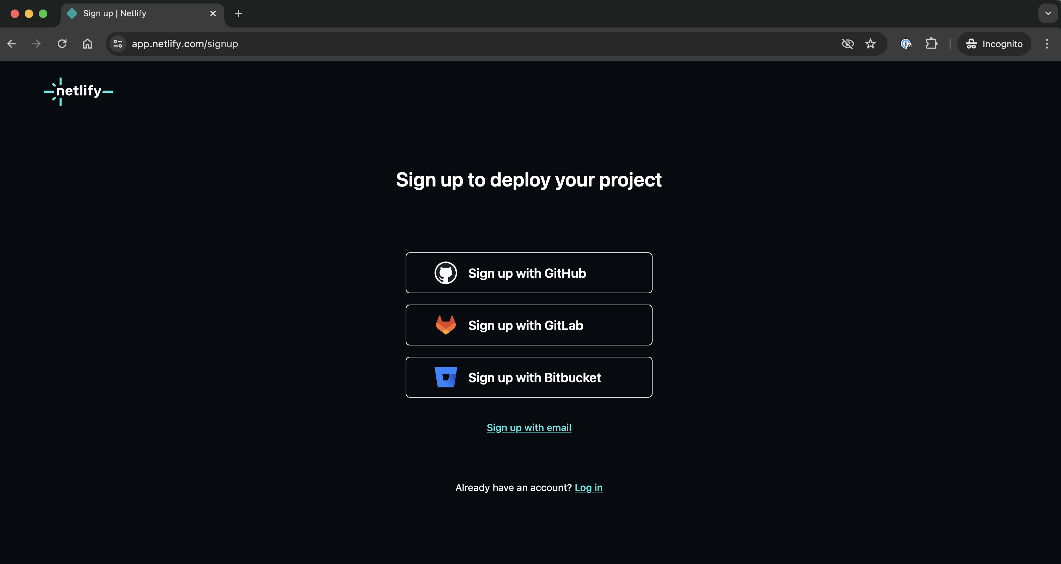
Sign up for a starter netlify account with your github identity

Slide 10
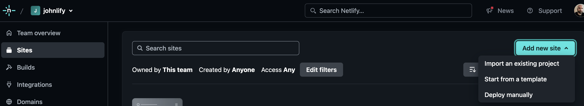
Add a new site – import existing project

Slide 11
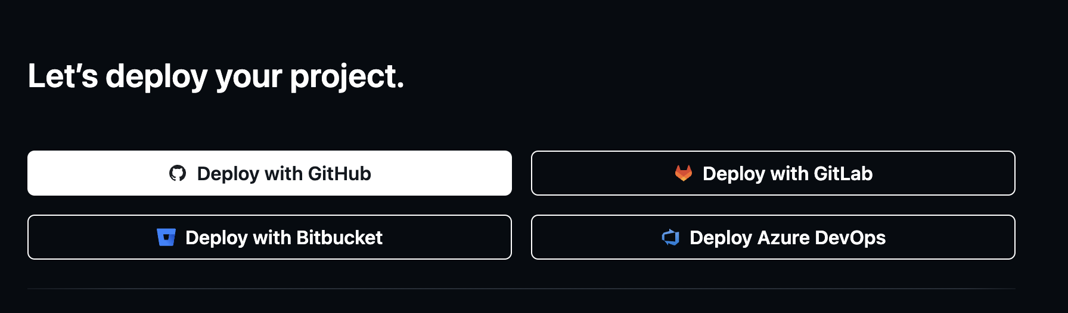
Deploy with github

Slide 12
Connect your github account to netlify
This should be a case of accepting and clicking to confirm, if not, shout for help

Slide 13
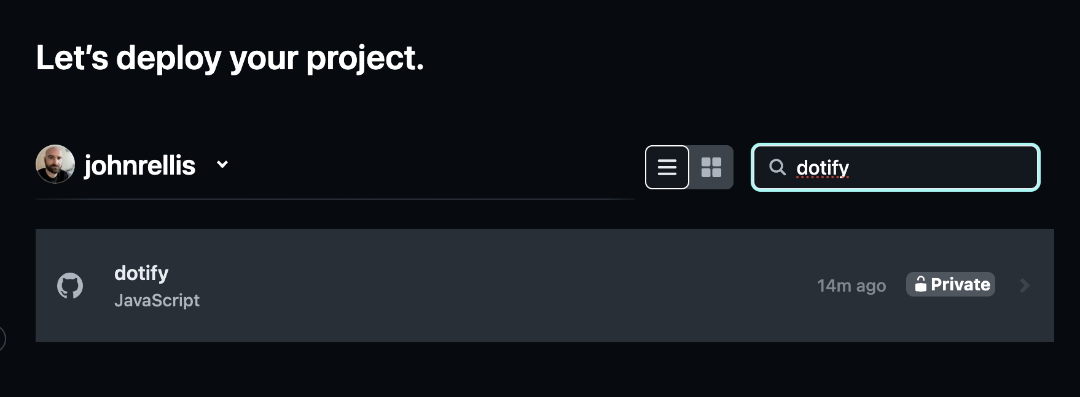
Select your newly created repo

Slide 14
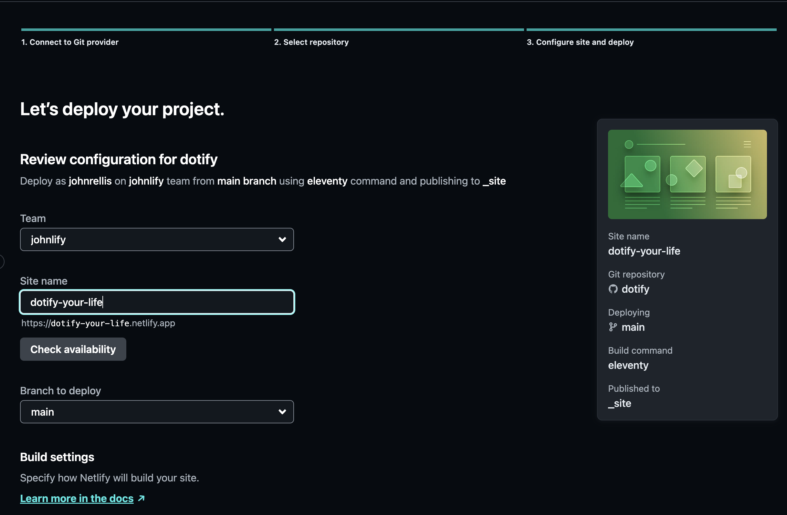
Confirm all the settings are correct
Netlify can typically tell you are running eleventy autoconfigure
Ensure the following settings
Branch to Deploy = main
Build Command = eleventy
Publish directory = site

Slide 15

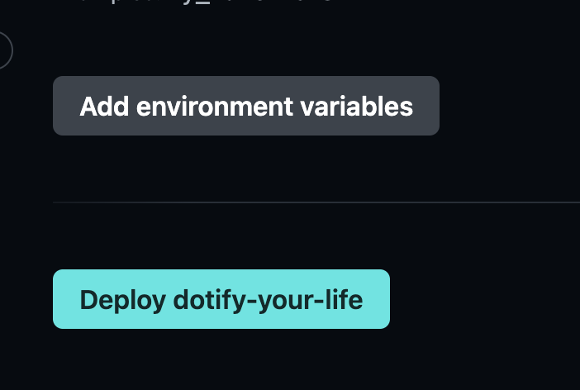
DEPLOY!

Slide 16
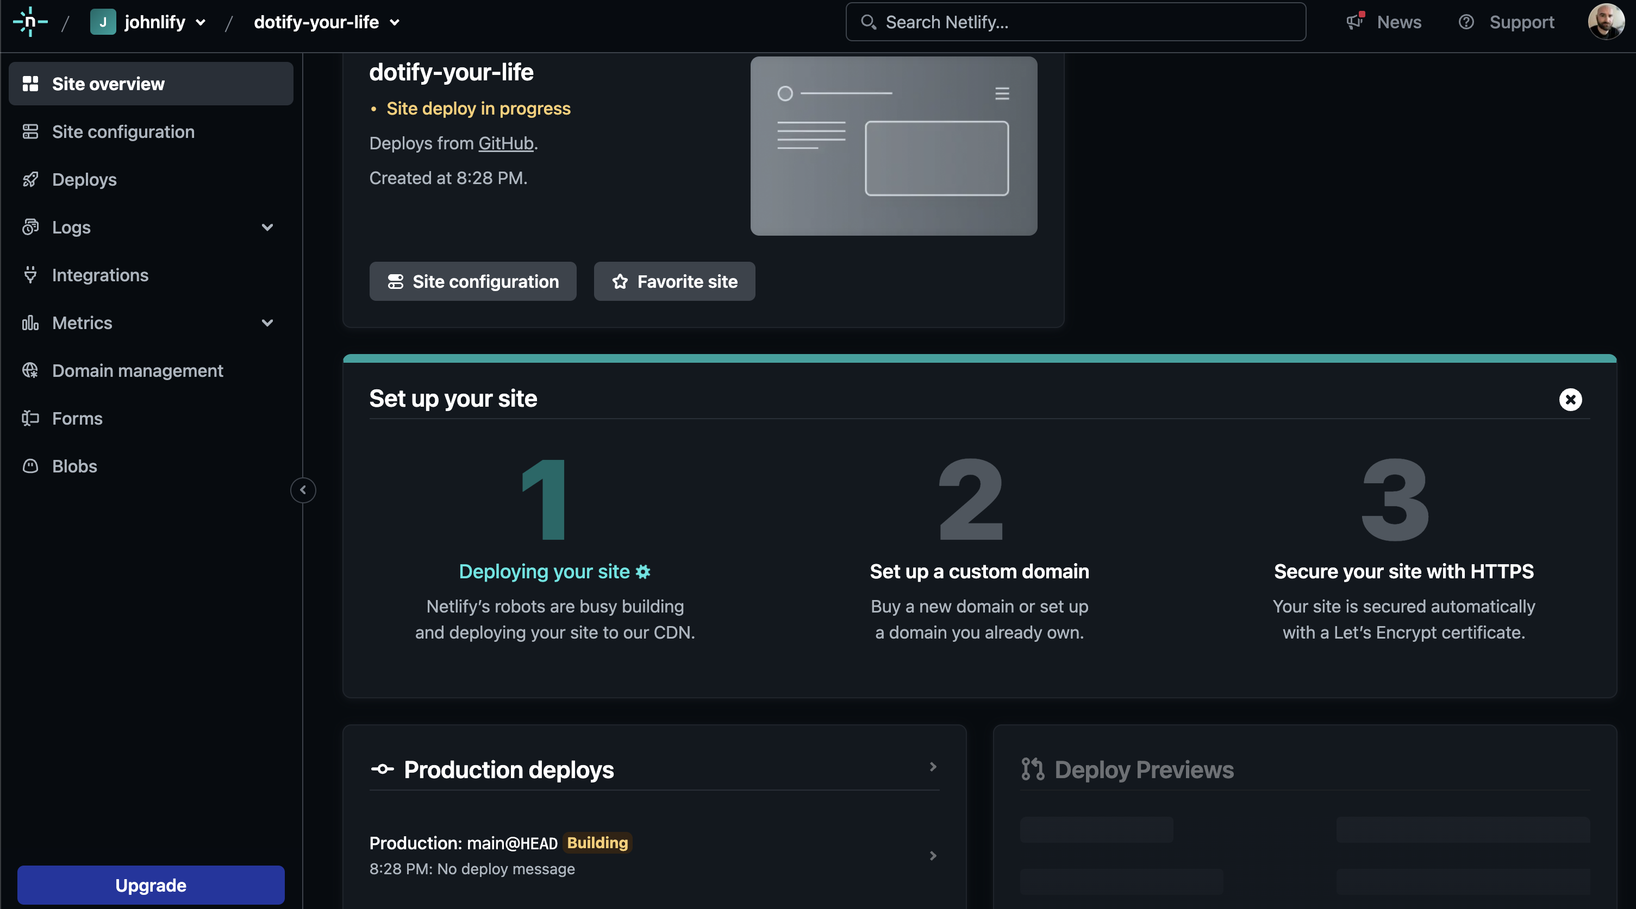
Your app will start building

Slide 17
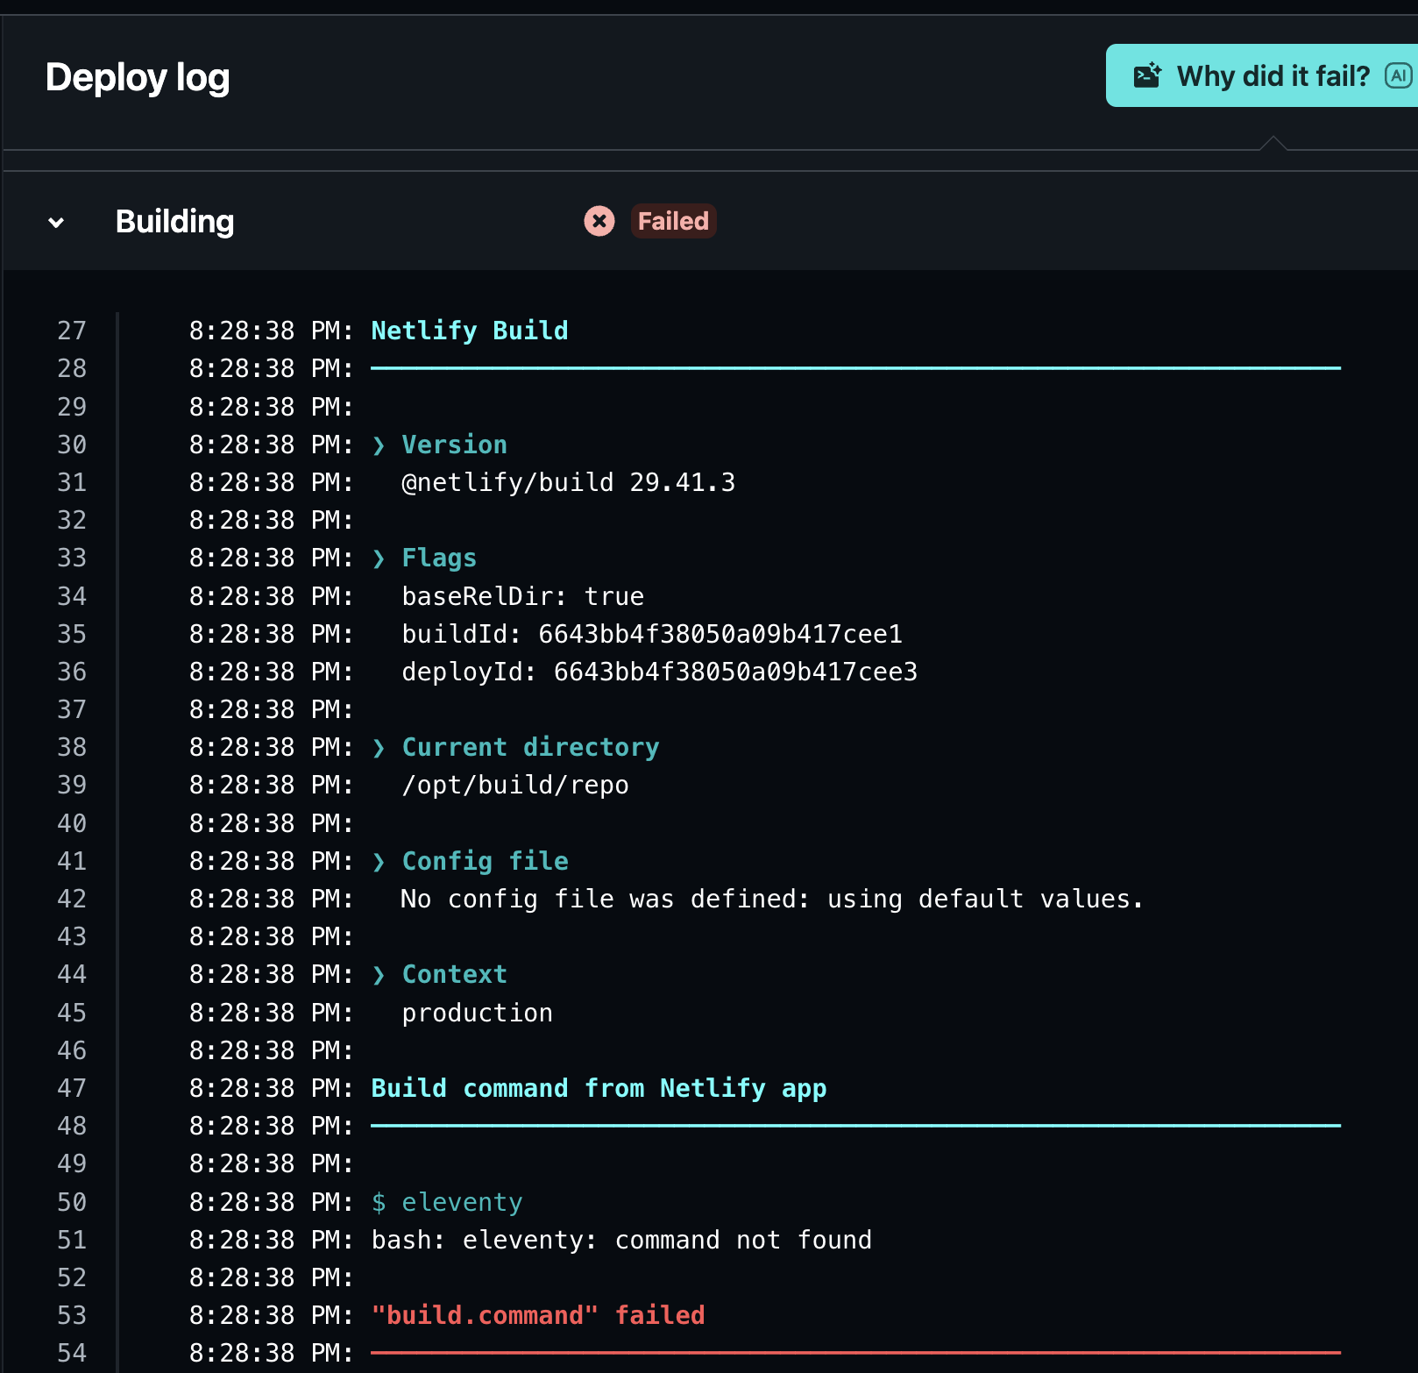
IT FAILED!

Slide 18
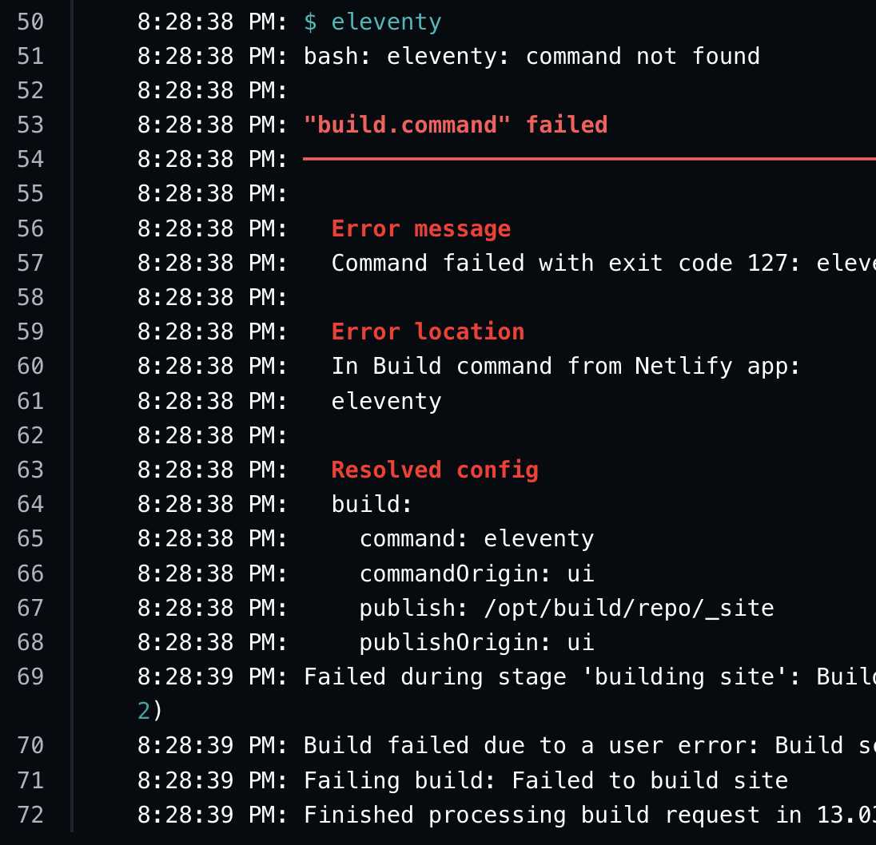
Ah, no eleventy

Slide 19
Why did this happen?
Build agents are typically virtual machine images or containers with a basic linux install, so eleventy isn’t installed
Some build agents allow you to run an install phase but this can be expensive when running builds on commits
An alternative is to install eleventy to our node_modules and run it from there with a custom npm script, we’ll do that now.

Slide 20
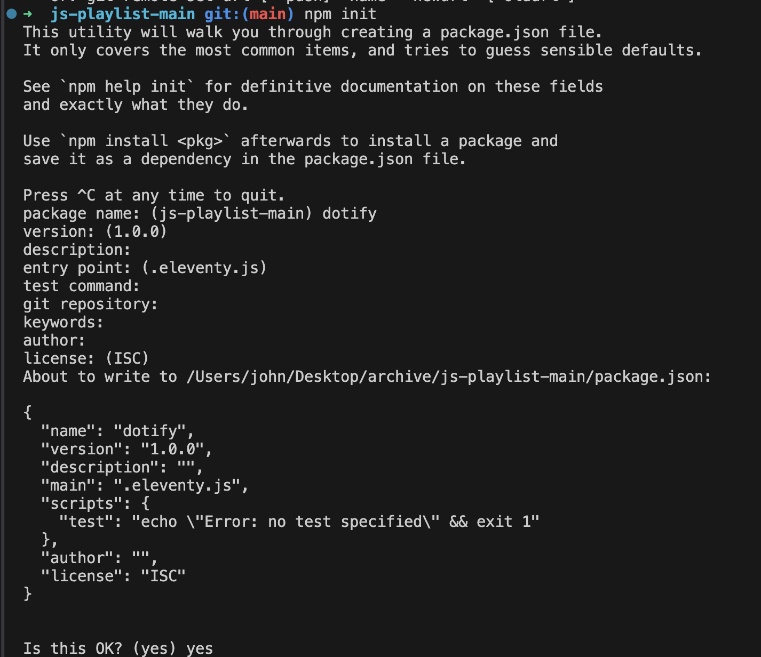
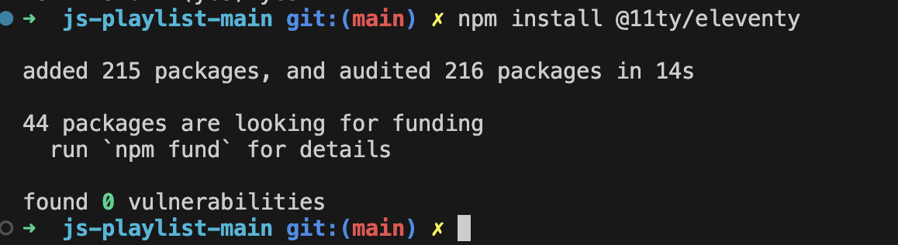
Add a package.json to our project and install eleventy (locally)

Slide 21
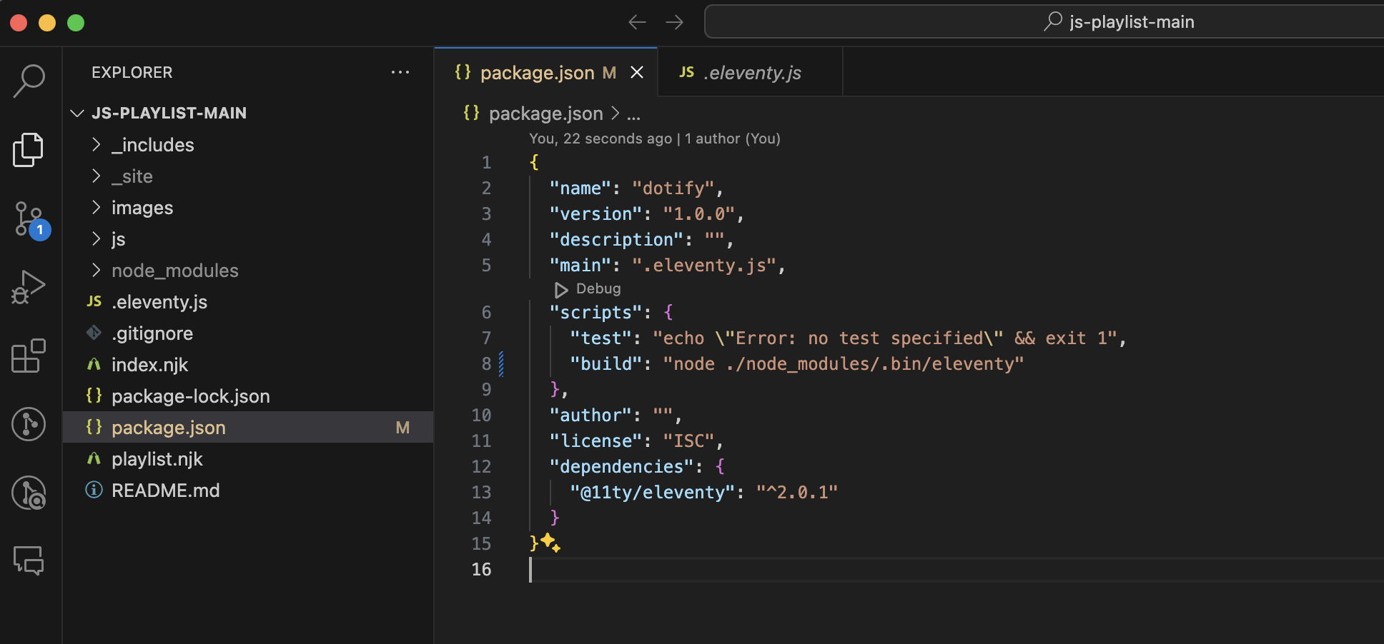
Add npm build script in package.json
Add this here

Slide 22
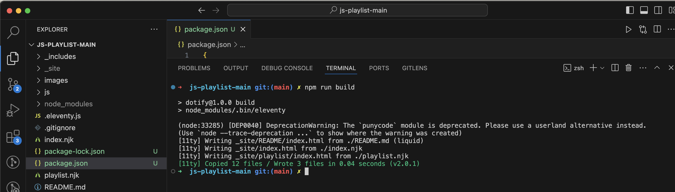
Run a build locally to confirm

Slide 23
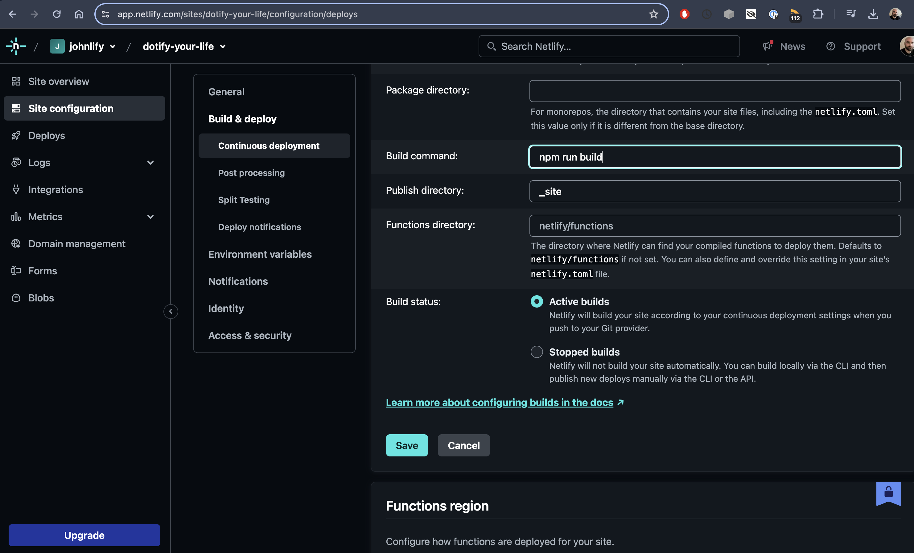
Change eleventy to run npm run build

Slide 24
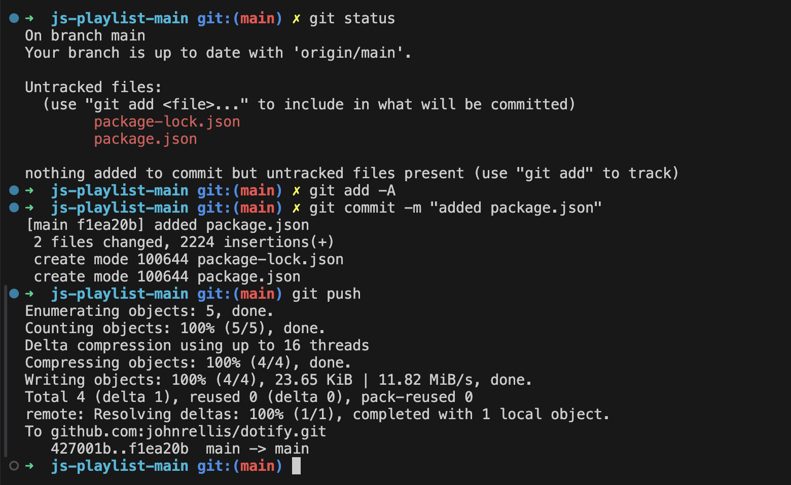
Push up our changes

Slide 25
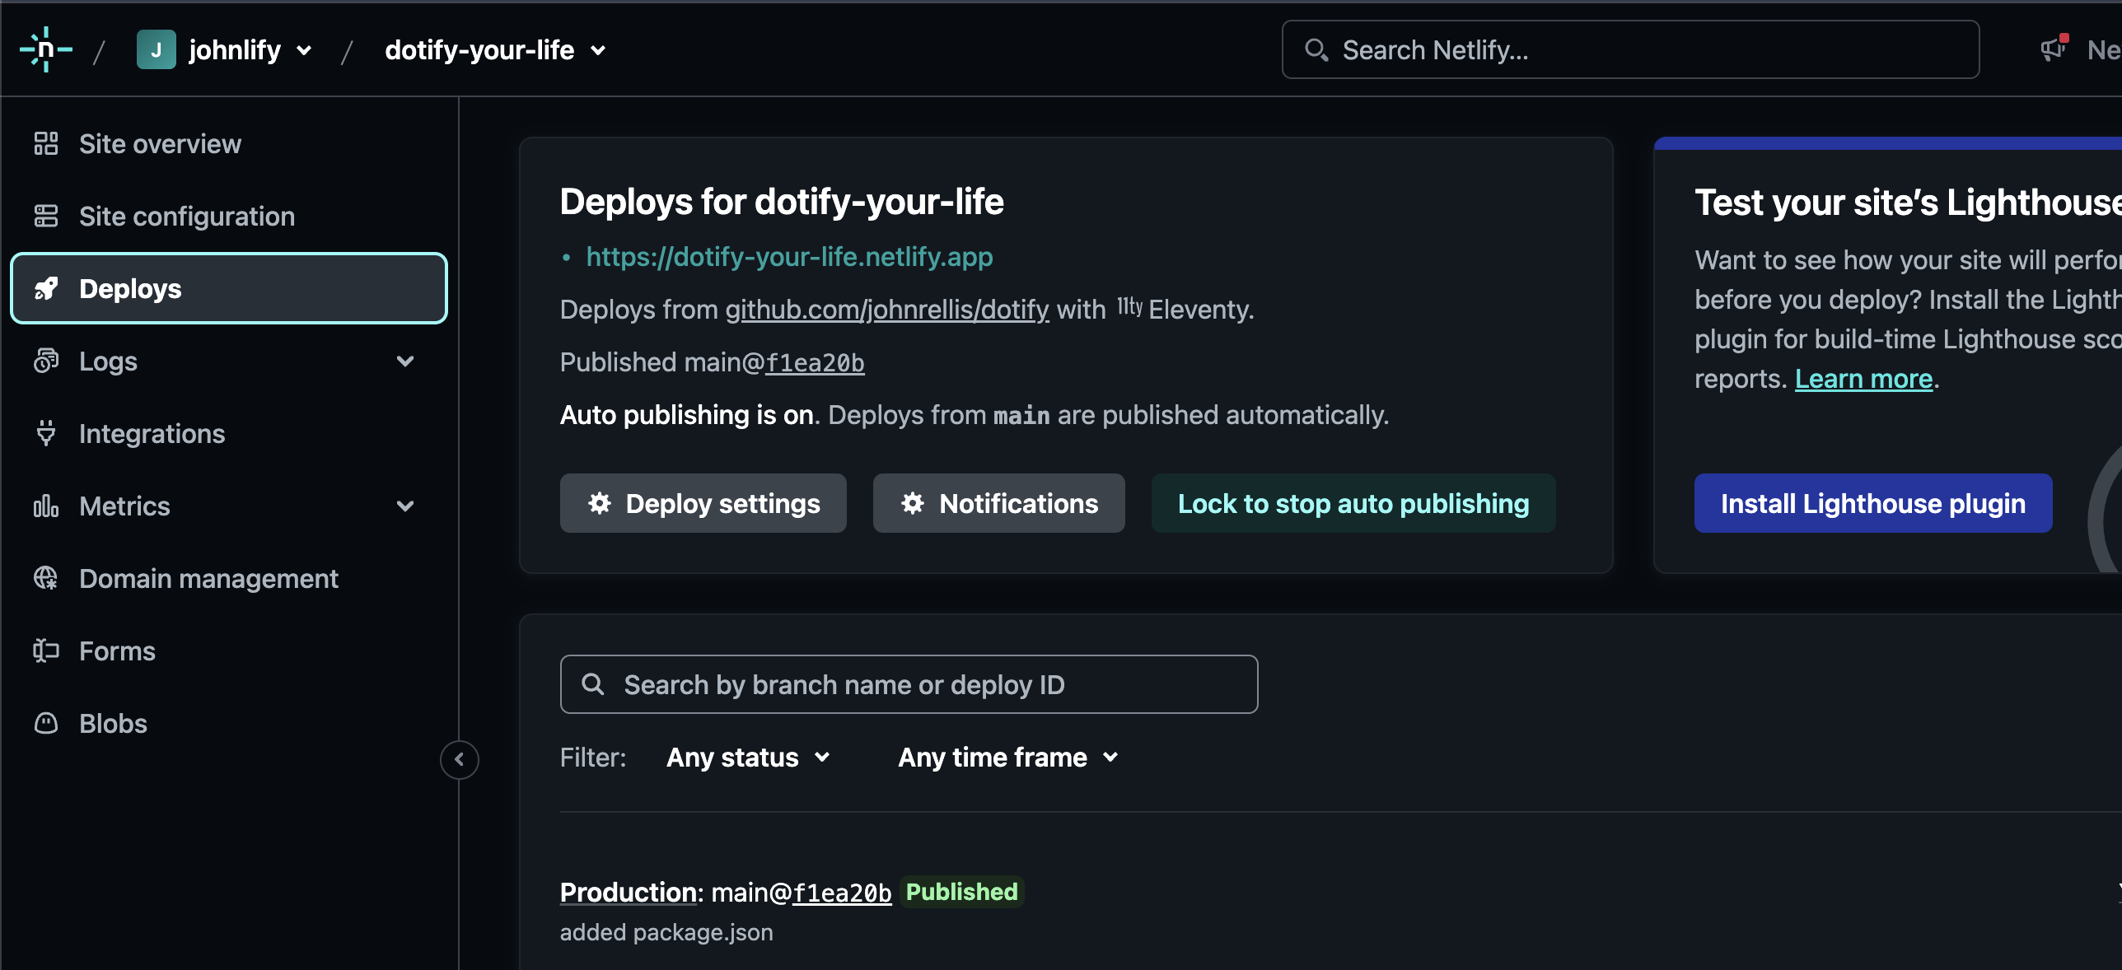
Now, let’s check netlify 🤞

Slide 26
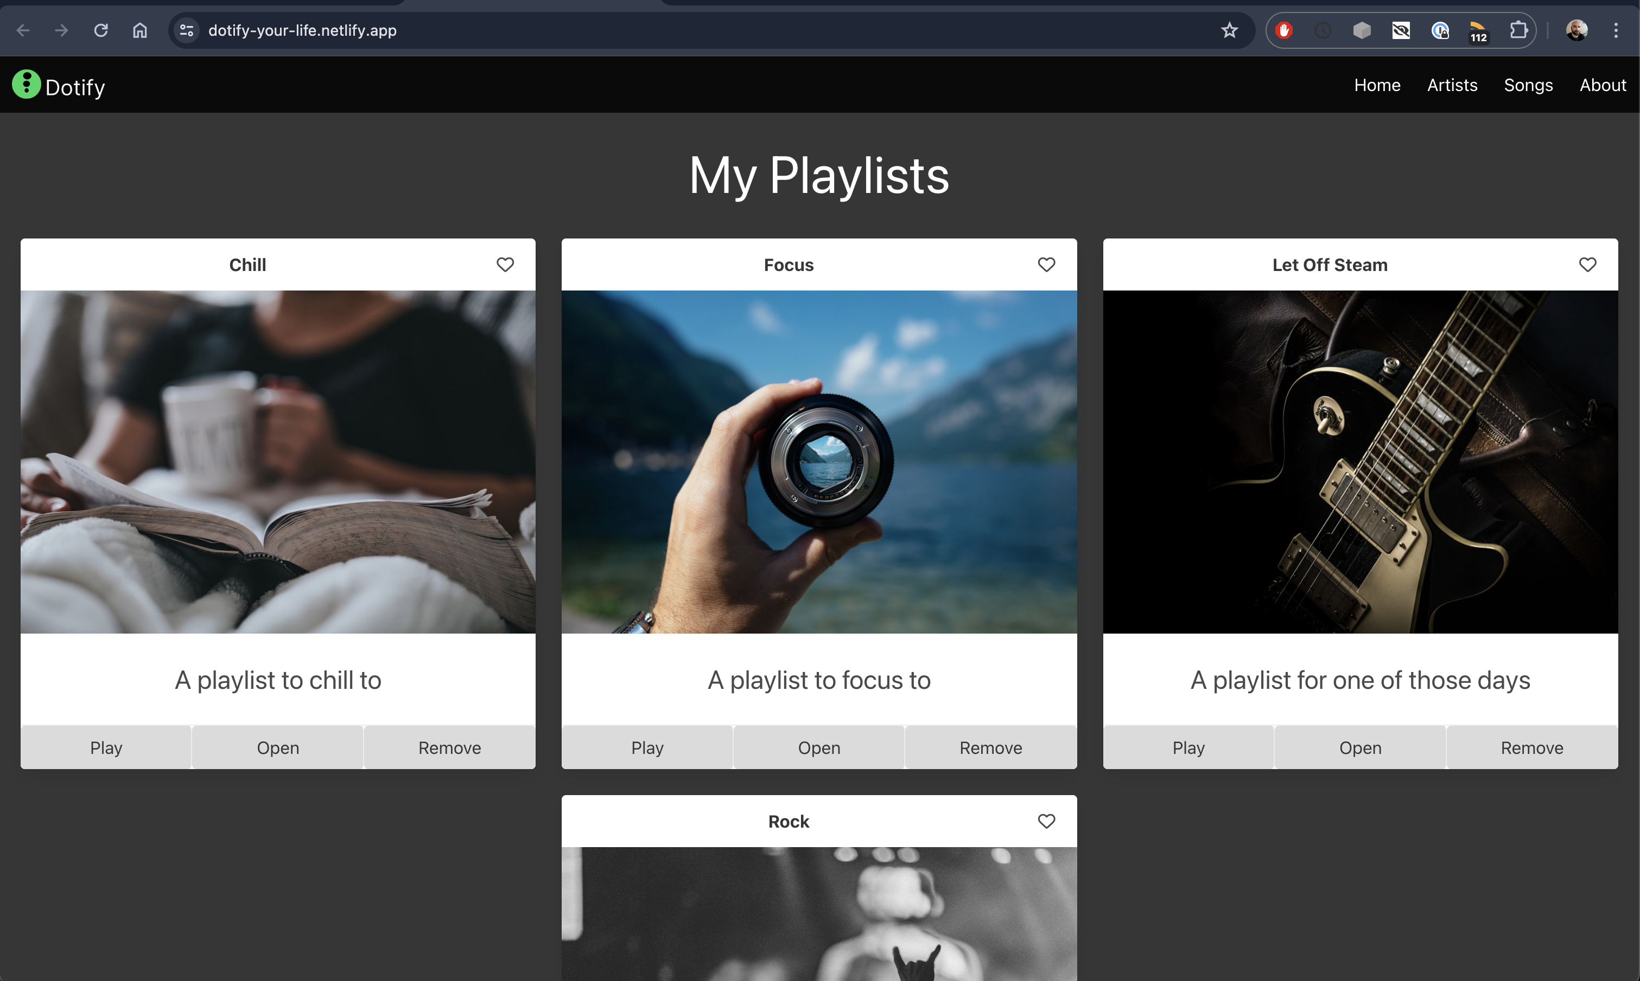
Success!

Slide 27
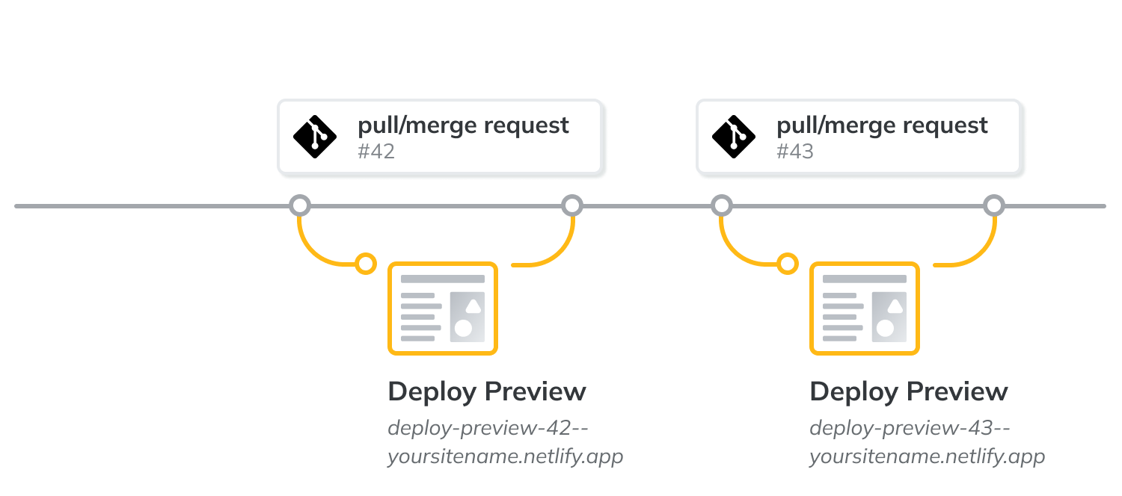
Is it a good idea to deploy from main?
It depends on your operations process
Typically, main can be locked to commits and only an approved pull request is allowed to be merged
It is possibly to set up netlify to publish previews of changes too
https://docs.netlify.com/site-deploys/overview/#branches-and-deploys

Slide 28
Is that gitops?
That is a tiny bit of gitops, we have essentially implemented naive continuous deployment
A CICD pipeline is typically made up of Continuous Integration and Continuous Delivery, usually with a human in the loop (a reviewed PR and/or a release gate)
Automated testing sprinkled everywhere too
CICD pipelines can be custom made or off the shelf, you probably shouldn’t try to make your own

